Slide 1

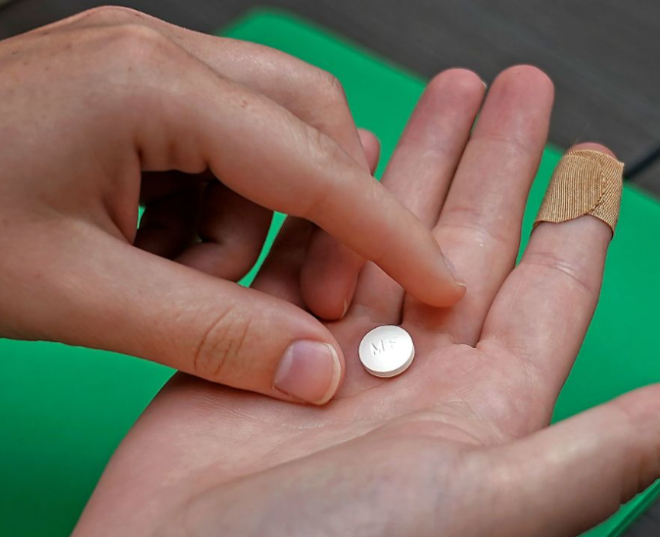
Team 5 - drug administration (FDA) Recalls
Chris
Alyssandra
Sabrina
Hunter
lakshmi

Slide 2

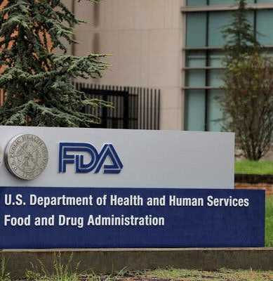



Which firms have the most recalls? How much Time does it take to close a recall? Which States are impacted by recalls? What are the types of recall classifications?

Slide 3
Background FDA
The FDA is a US government agency which is part of the Department of Health and Human Services. The FDA's mission is to protect public health by regulating and ensuring the safety, efficacy, and security of many products. One of these products include food items.
01
Drug items in violation of the US FDA regulations are recalled, which removes the recalled food item from the market.
02
We analyzed 500 recalled Drugs from the FDA for the time period of Jan-2020 – Aug-2024.
03

Slide 4
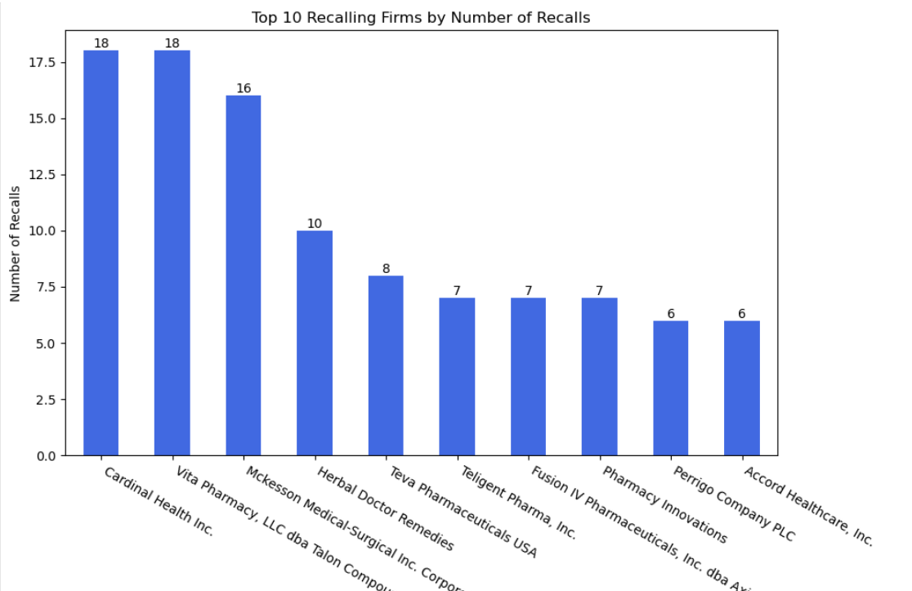
Which firms have the most recalls?
Recalling Firm Cardinal Health Inc. 18 Vita Pharmacy, LLC dba Talon Compounding Pharmacy 18 Mckesson Medical-Surgical Inc. Corporate Office 16 Herbal Doctor Remedies 10 Teva Pharmaceuticals USA 8 Teligent Pharma, Inc. 7 Fusion IV Pharmaceuticals, Inc. dba Axia Pharmaceutical 7 Pharmacy Innovations 7 Perrigo Company PLC 6 Accord Healthcare, Inc. 6
Recalling Firm Cardinal Health Inc. 18 Vita Pharmacy, LLC dba Talon Compounding Pharmacy 18 Mckesson Medical-Surgical Inc. Corporate Office 16 Herbal Doctor Remedies 10 Teva Pharmaceuticals USA 8 Teligent Pharma, Inc. 7 Fusion IV Pharmaceuticals, Inc. dba Axia Pharmaceutical 7 Pharmacy Innovations 7 Perrigo Company PLC 6 Accord Healthcare, Inc. 6
Total amount of unique Recalling Firms associated to the FDA Recalls is 132
Narrowed down to top 10
Top 10 Recalls by Number of recalls.

Slide 5
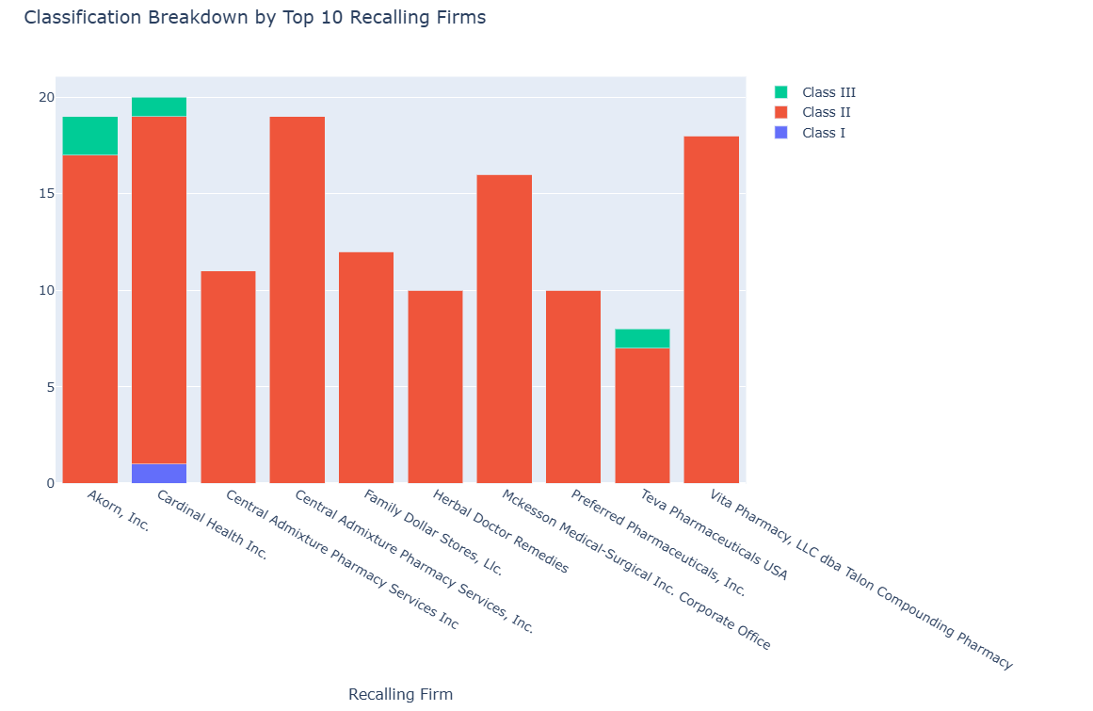
Which firms have the most recalls?
Class I = Dangerous or defective products that predictably could cause serious health problems or death. Examples problem or food found to contain botulinum toxin, food with undeclared allergens, a label mix-up on a lifesaving drug, or a defective artificial heart valve.
Class II = Products that might cause a temporary health problem or pose only a slight threat of a serious nature. Example: a drug that is under-strength but that is not used to treat life-threatening situations.
Class III = Products that are unlikely to cause any adverse health reaction, but that violate FDA labeling or manufacturing laws. Examples include: a minor container defect and lack of English labeling in a retail food.

